Slide 1
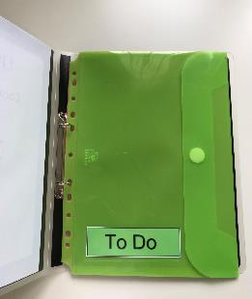
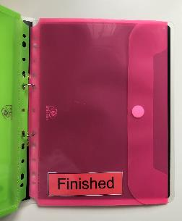
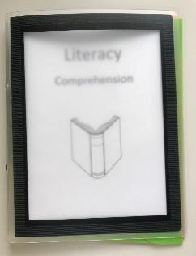
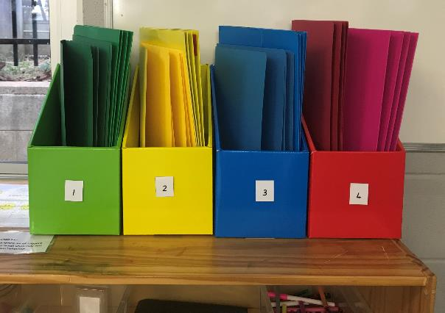
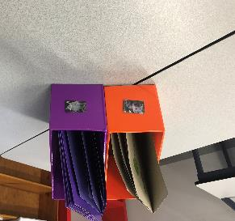
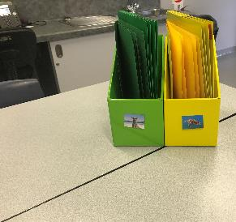
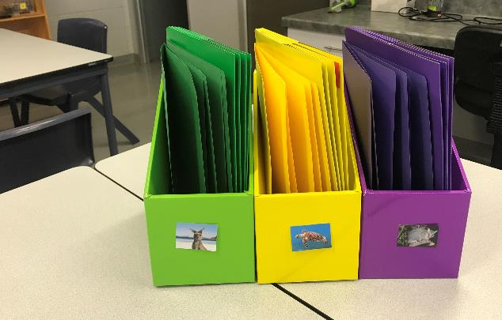
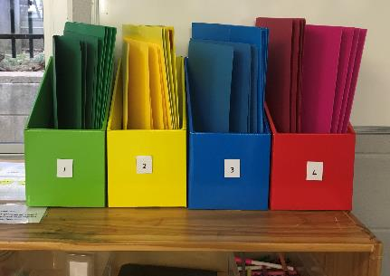
Work Systems Examples
Teacher Professional Development
Individual Work Systems
Individual work systems can be implemented as a group
Group Work Systems
Numbered work system Group rotation activities on desks
Option for further work systems in each box
Matching, numbered, or colour coded – change number of boxes to suit design of work system
Whole-of-class Work System
This ‘Group’ Work System setup can also be implemented for Whole-of-Class.
Materials required
Matching use of images
(numbers of words)
Title of activities
(laminate & attach using Velcro to easily change)
Identify a clear ‘Finished’ area for students to put their completed work (this could be in the ‘Finished’ part of the folder or hanging pocket OR in a separate container/basket/ folder designated by the teacher).

