Slide 1
Structured Teaching
VISUAL SCHEDULES
Teacher Professional Development

Slide 2
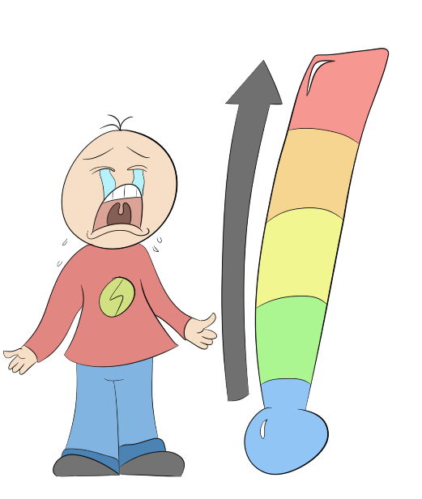
Do you have students in your classroom who…..
Do some students experience difficulty with transitions….
Don’t know where to go?
And annoy the other students?
Appear confused?
Or what to do next?
And students are not
where they are meant to be
OR
doing the intended activity
Or express
an increase
in meltdowns?
Visual Schedules to the Rescue!

Slide 3
Teacher Professional Development
Ed the Schedule welcomes you
to this Teacher Professional Development
on Visual Schedules

Slide 4
Teacher Professional Development
Overview of Structured Teaching
Visual Schedules
In this Teacher Professional Development, you will find practical information on the following:
What are Visual Schedules?
Background information & examples of Visual Schedules
Why use Visual Schedules?
Benefits of Visual Schedules
When to use Visual Schedules?
How to use Visual Schedules?
3 step approach for Whole-of-Class & Individualised Schedules
Your Checklist for implementing Structured Teaching Visual Schedules in the classroom

Slide 5
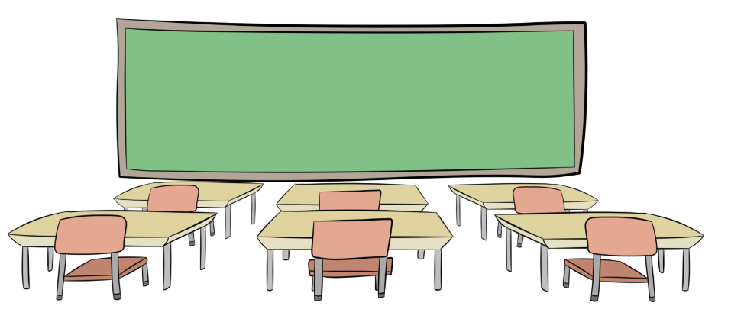
What are Visual Schedules?
Teacher Professional Development
Visual Schedules are a visual representation of a sequence of activities or events.
Visual Schedules tell students WHERE to be and WHEN to be there.
Visual Schedules may be whole-of-class
Visual Schedules may also be individualised for 1 or more students

Slide 6
What are Visual Schedules? continued
Teacher Professional Development
Visual Schedules are recognised as an evidence-based practice for individuals on the spectrum
and can be used for all students.
Examples of Visual Schedules
Visual Schedules may include:
Images
Pictures
Words
Photographs
Numbers
Individualised Schedule
Whole-of-Class Schedule

Slide 7
Teacher Professional Development
Why use Visual Schedules?
Visual Schedules facilitate teaching and learning of transition behaviours and on-task behaviours for all students and have the potential to support Active Learning* in the classroom.
Supports receptive language
Supports retention & recall of information
Fixed point of reference
Improves sense of self-efficacy
Option for personalisation
Shows what is expected
Provides easily accessed reminders and visual prompts of class routine or activity
Reduces stress & anxiety about order of events or activities
Increases feelings of security & control over self and session/day
More meaningful for individual students & increases motivation
* Active Learning refers to students participating in meaningful activities where they are more
engaged in thinking and doing.

Slide 8
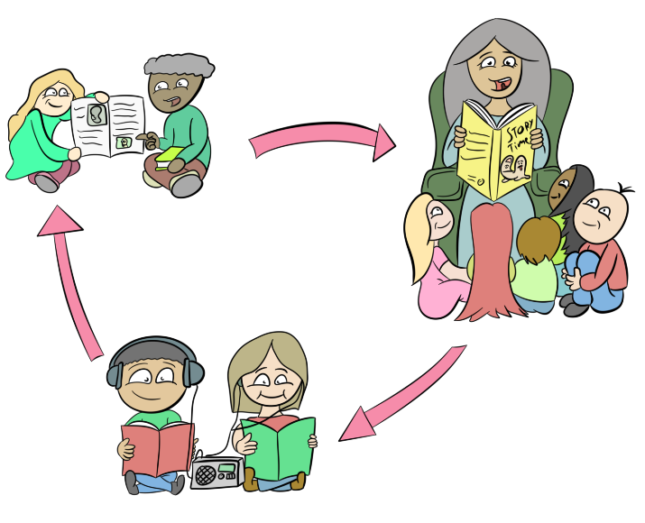
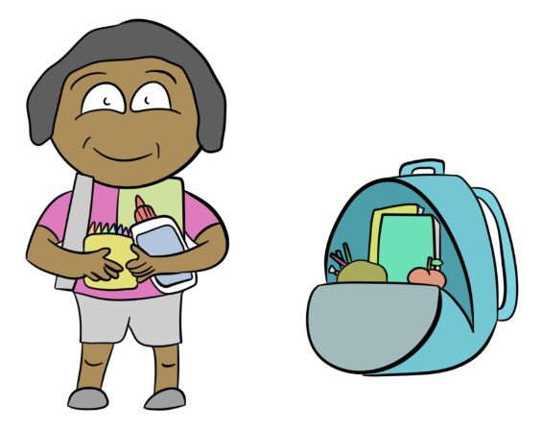
Teacher Professional Development
Benefits of Visual Schedules
Positive Student Outcomes
An INCREASE in
Engagement in
on-task behaviour
Planning &
organising skills
Transitioning between tasks more smoothly
Independence

Slide 9
Teacher Professional Development
Benefits of Visual Schedules
Positive Teacher Outcomes
A DECREASE in
Challenging behaviour
Stress
On-task behaviour
(BENEFITS FOR TEACHERS)

Slide 10
When to use Visual Schedules?
Teacher Professional Development
Visual Schedules are used to provide structure to a routine and help to provide clarity and consistency for students.
Sessions
Special Events
Lunch Breaks
Activities/ Lessons
Individual Days, Week, Month, Year
The aim of Visual Schedules is to help students progress towards functioning independently.

Slide 11
How to use Visual Schedules
Teacher Professional Development
There are 3 MAIN steps to implementing Visual Schedules in the classroom.
Step 1. Assess your students’ needs
Step 2. Design the Schedule
Step 3. Implement the Schedule in the classroom
Options include
Whole-of-Class
Individualised
Follow the same steps for a Whole-of-Class OR Individualised Visual Schedule

Slide 12
Step 1. Assess your students’ needs

Slide 13
How to use Visual Schedules continued
Teacher Professional Development
Step 1. Assess your students’ needs
There are three sections within this step.
Look at each section.
Within each section, answer each question about the students in your class to determine what information to include and
how best to present this information.
A
Time Period
B
Format & Location
C
Use & Ability

Slide 14
How to use Visual Schedules continued
Teacher Professional Development
Step 1. Assess your students’ needs
A
Time Period
B
Format &Location
C
Use & Ability
1A. Choose a TIME PERIOD. Consider the school timetable.
Part Day (Morning, Middle, Afternoon session)
Whole Day (Individual days of week e.g. Monday)
Part Week/ Whole Week
Group Rotations
Sequence of Activities/Lesson
Month or Year are optional however consider
the age, ability and needs of your students

Slide 15
How to use Visual Schedules continued
Teacher Professional Development
Step 1. Assess your students’ needs
A
Time Period
B
Format &Location
C
Use & Ability
1A. Choose a TIME PERIOD. Consider the following questions:
What type of schedule might your students need to learn how to use in classroom environments?
Aim for the majority of students while the remainder can be individualised if needed
How far ahead in the classroom routine do your students need to prepare and plan?
This may vary from an activity to a morning session to a whole day to a week
How much information do the students need at one time?
Be mindful of your students’ ability to recall information and follow steps
What time period best suits the needs of your students?
Aim to provide clarity and certainty
Focus on helping them transition through the classroom routine

Slide 16
How to use Visual Schedules continued
Teacher Professional Development
A
Time Period
B
Format &Location
C
Use & Ability
1B: Decide on FORMAT & LOCATION. Consider the following questions:
When and where in the class routine will the schedule be used?
e.g. Beginning of an activity, entry into classroom or start of day
Where will you locate the schedule in your classroom?
Be consistent throughout classroom routine
Place where students can physically access
Aim to facilitate smooth transition between activities
Will the schedule be stationary or mobile?
In a fixed location for viewing by whole class or individual student
Easily transported by students
Where will you store any resources for your schedule?
On your whiteboard, in a nearby container, on the schedule, in a zip lock bag, other?
What will the schedule be made of?
Paper, laminated paper, Post-it note, whiteboard marker, pencil, pen, iPad, computer

Slide 17
How to use Visual Schedules continued
Teacher Professional Development
A
Time Period
B
Format &Location
C
Use & Ability
1C: Determine USE and ABILITY. Consider the following questions:
How will students look at the schedule?
e.g. Fixed – front of room or on desk; Mobile – paper, small whiteboard or iPad
Who will make changes to the schedule – teacher or student?
Whole Class – teacher, Individualised – student
How will students or you (the teacher) manipulate the schedule?
Velcro, Blu Tack, magnets, whiteboard marker, chalk, pen, pencil, other
What is the range of visual literacy skills of your students?
Do they understand or interpret photographs, images, pictures, symbols, numbers or the written word?
How can special interests be incorporated into the schedule to draw each students’ attention to the timetable?
“Put me in the same place,
all the time where I’m easy to see and the centre of attention!”

Slide 18
Step 2. Design the Schedule

Slide 19
How to use Visual Schedules continued
Teacher Professional Development
Step 2. Design the Schedule
Using the information from Step 1, design and create a timetable to be used by all students in the classroom. Other tips include:
Left to Right*
Top
to
Bottom
Written words
Symbols
Colour Coding
Objects
Photographs
Drawings
Using a consistent visual structure
Include social interactions or reminders of specific rules for different situations/contexts
(e.g. quiet voice in library)
*This is dependant upon cultural viewing of text from left to right OR right to left

Slide 20
How to use Visual Schedules continued
Teacher Professional Development
Step 2. Design the Schedule continued
Whole-of-Class Visual Schedule can be used as a whole-of-class strategy (placed in easy to view & constant location).
Be mindful of clarity and reduced visual clutter surrounding the Visual Schedule.
Individualised Visual Schedule located on each desk.
Be mindful of available space and size of Visual Schedules.

Slide 21
How to use Visual Schedules continued
Teacher Professional Development
Step 2. Design the Schedule continued
Students may assist in designing and individualising their own schedule.
Use sets of schedules where routines are repeated over a period of time (e.g. week, term).

Slide 22
Step 3. Implement the Visual Schedule in the classroom

Slide 23
How to use Visual Schedules continued
Teacher Professional Development
Step 3. Implement the Visual Schedule in the classroom
Introduce
Explain the Visual Schedule to students
Teach Students
How, when and why to use the Visual Schedule
On First Use
Prompt class to refer to Visual Schedule at transition times, when activities are changed or removed from the schedule OR mark off for finished work, mark changes, add extra tasks
Adapt Classroom Routine
Use a regular and consistent transition action for students to check Visual Schedule upon finishing one activity & moving to next activity
Student Queries
When a student is uncertain about what to do, or asks a question that the Visual Schedule can answer, prompt/redirect the student to the Visual Schedule

Slide 24
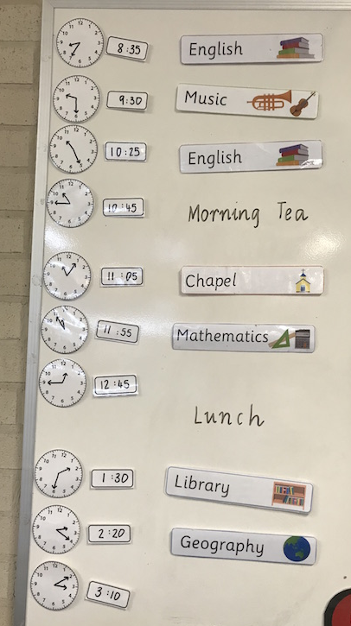
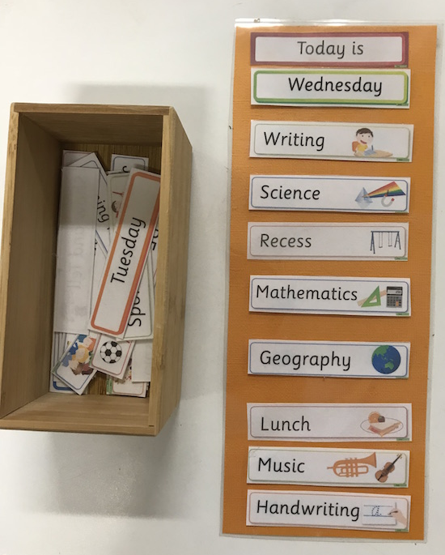
Examples from teachers’ classrooms
Teacher Professional Development

Slide 25
Teacher Professional Development
Your checklist for Structured Teaching:
Visual Schedules
Step 1. Assess your students’ needs
Look at Time Period, Format & Location, Use & Ability for a Whole-of-Class or an Individualised Visual Schedule.
Step 2. Design the timetable
Be mindful of aiming for visual clarity and reducing visual clutter when designing and creating a Visual Schedule.
Step 3. Implement the Visual Schedule in the classroom
Follow each step of Introduce, Teach Students, On First Use, Adapt Classroom Routine, Student Queries.

Slide 26
A final note from Ed the Schedule
This Teacher Professional Development on Visual Schedules was created and developed by Dr Satine Winter and overseen by Dr Jill Ashburner, Autism Queensland.
The information contained within is adapted from the ‘Finished! The On-Task Toolkit – A teacher’s guide to using visual schedules and work systems in the mainstream classroom’ by Elizabeth Macdonald (Autism CRC funded PhD scholar, Griffith University) and Kaaren Haas (Autism Spectrum Australia, Aspect).
Teacher vignettes were presented by Elizabeth Scales. Animated images and filming of vignettes were created by Studio G, Autism Queensland.
Funding for this project was provided by Positive Partnerships and facilitated through project collaboration between the Autism CRC, Autism Queensland, Positive Partnerships, Autism Spectrum Australia (Aspect) and the University of Queensland.

Slide 27
Autism CRC is the world’s first national, cooperative research centre focused on autism. We are taking a whole-of-life approach to autism focusing on early years, schools years and adulthood.

