Slide 1
Structured Teaching
INTRODUCTION
Teacher Professional Development

Slide 2
Teacher Professional Development
Overview of Structured Teaching
An Introduction
In this Teacher Professional Development, you will find practical information on the following:
What is Structured Teaching?
Focus of Structured Teaching
Elements of Structured Teaching
Physical Structure
Visual Schedules
Work Systems
Visual Structures
‘Culture of Autism’ and Structured Teaching
How does Structured Teaching work?
Benefits of Structured Teaching
Some resources on Structured Teaching

Slide 3
What is Structured Teaching?
Teacher Professional Development
A comprehensive intervention originally designed to support students on the autism spectrum
Designed in view of the characteristics of autism that affect learning¹
Derived from the Treatment and Education of Autistic and related Communication Handicapped Children (TEACCH®) program at the University of North Carolina
Often used in special schools, autism-specific schools and has been used in a other contexts (e.g. workplace, home)
Used with individuals on the spectrum of all ages and functioning levels²
¹ Mesibov, Shea, & Schopler, 2004.
²Mesibov & Shea, 2011.
Notes:
(Hume, 2015)
TEACCH® is a treatment model that serves individuals with autism across the lifespan. It is based on:
an extensive understanding of autism
partnering with families
individualized assessment for the purpose of developing and delivering strategies
developing skills across curriculum areas, especially the development of communication and social skills (with attention to the development of communication and social skills).

Slide 4
What is Structured Teaching? continued
Teacher Professional Development
The Structured Teaching approach aims to modify the environment to enhance meaning for students and increase their academic and adaptive skills¹. Research indicates that these modifications should include:
Structured sessions for learning experiences
Instructions given primarily via visual information
Explicit organisation of materials²
This Autism CRC project focused on the use of two of its elements (Visual Schedules and Work Systems) in mainstream classrooms³.
¹ Mesibov, Shea, & Schopler, 2004.
² Schopler et al., 1971; Schopler, Mesibov, & Hearsey, 1995; Mesibov, Shea, & Schopler, 2004; Hume & Odom, 2007.
³ MacDonald, Keen, Ashburner, Costley, Haas, & Trembath, 2017.

Slide 5
What is Structured Teaching? continued
Teacher Professional Development
Structured Teaching provides a systematic approach to learning and teaching through the:
Organisation of learning environment
Routine, structure and visual clarity
Reduce STRESS
Reduce FRUSTRATION
Reduce ANXIETY
Structured Teaching meets students’ needs by
Individualising materials and methods
Using individual interests or strengths
For students on the spectrum
For other students in the classroom
For you, as a teacher!

Slide 6
Teacher Professional Development
The Focus of Structured Teaching
Create a structured & predictable environment
Clearly defining tasks & expectations
Catering to the ‘culture of autism’
Working with the STRENGTHS & INTERESTS of each student

Slide 7
Teacher Professional Development
Elements of Structured Teaching
1.
Physical Structure
2.
Visual Schedules
3.
Work Systems
4.
Visual Structures
There are 4 main elements* of Structured Teaching that provide a framework in supporting students.
These elements support the creation of a structured and predictable environment combined with clearly defined tasks and expectations while catering to the culture of autism.
* Research across the field of TEACCH varies and some authors or information may identify or state a 5th element of Structured Teaching or slightly reword the titles of each element. The overall principles of Structured Teaching are incorporated in the above 4 elements.

Slide 8
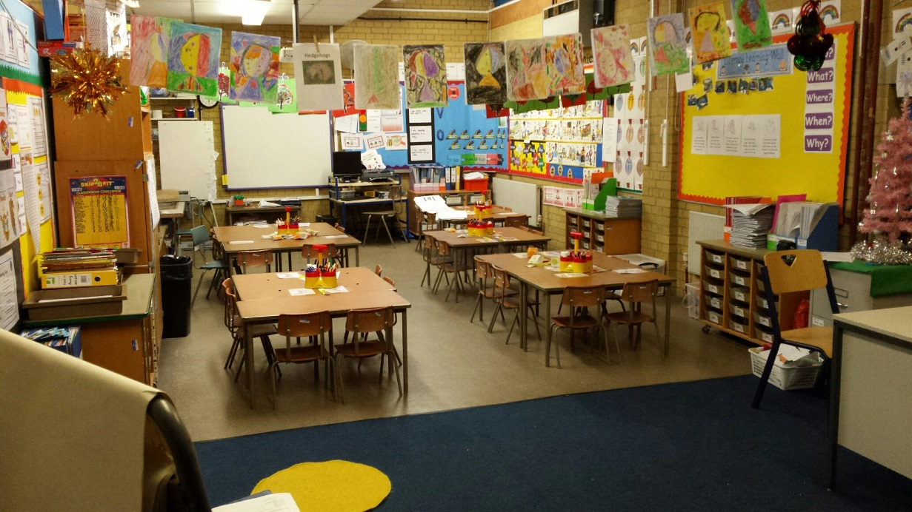
1. Physical Structure
Teacher Professional Development
Reduce the distractions hanging from the roof, on walls or around the room.
Organisation of classroom
Minimise visual & auditory distractions
1.
Physical Structure
2.
Visual Schedules
3.
Work Systems
4.
Visual Structures
Consider where you might place a student on the spectrum based on their needs
Clearly marked areas using equipment, carpet & walkways to organise classroom

Slide 9
2. Visual Schedules
Teacher Professional Development
Where
And
When
Visual information depicting the
‘where’
‘when’
‘what’ of an activity
What
1.
Physical Structure
2.
Visual Schedules
3.
Work Systems
4.
Visual Structures

Slide 10
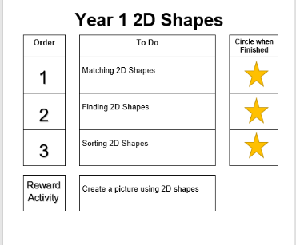
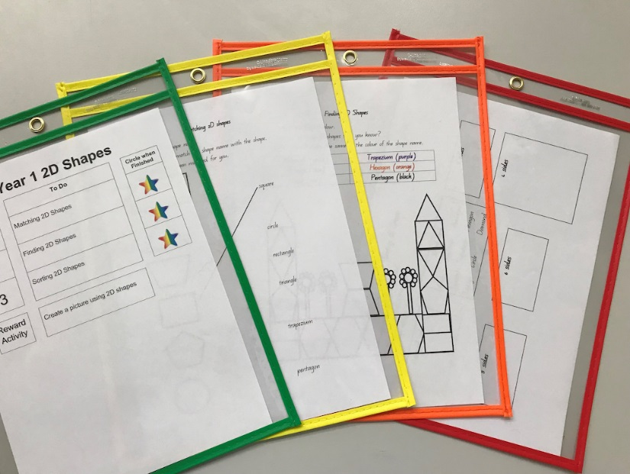
3. Work Systems
Teacher Professional Development
What to do
Visual information informing
‘what to do’
‘how much’
‘when it is finished’
and ‘what next’
How much
When
it is finished
1.
Physical Structure
2.
Visual Schedules
3.
Work Systems
4.
Visual Structures
What next

Slide 11
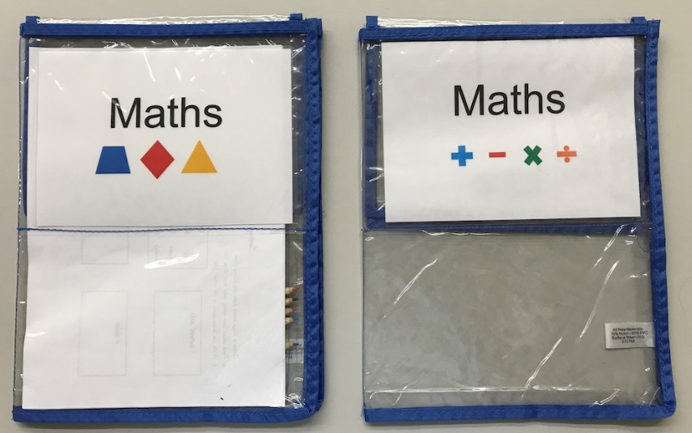
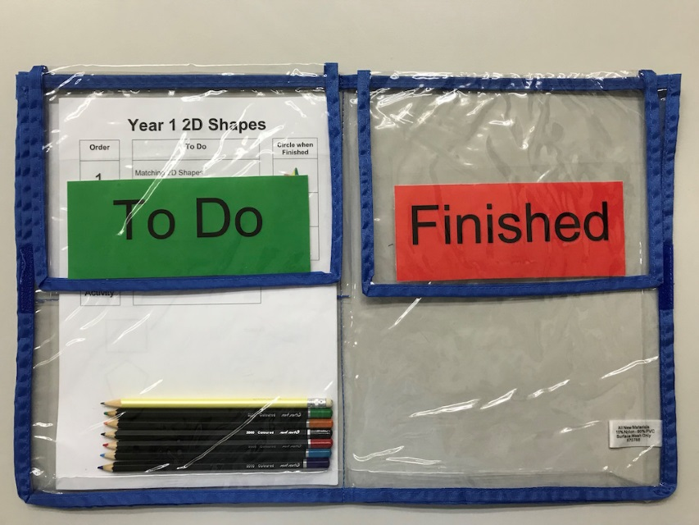
4. Visual Structures
Clear labelling with supporting images to match subject of activity
Visual clarity
colour coding, highlighting, labelling
Visual organisation
arrangement of materials and space
Visual instructions
clear information on where to start and to finish and the sequencing of steps
1.
Physical Structure
2.
Visual Schedules
3.
Work Systems
4.
Visual Structures
Separated folder sections with Velcro tabs to organise materials
Instructions on starting in To Do and moving work to Finished

Slide 12
‘Culture of Autism’ and Structured Teaching
Teacher Professional Development
Visual Processing
Attention to Details
Sensory
Communication
Concepts of Time
Intense interests & preferences
Specific Routines & Settings
The TEACCH approach, otherwise known as Structured Teaching, is based on using an approach that caters to the ‘culture of autism’.
Mesibov and Shea (2009) refer to the ‘culture of autism’ as a range of characteristics and patterns of behaviours of people on the spectrum.
Notes:
An in-depth look at the characteristics and patterns of behaviour which comprise the ‘Culture of Autism’ (Mesibov & Shea, 2009) is outlined below:
Visual Processing: A preference to process visual information which is explicit and concrete (rather than processing auditory information such as language)
Attention to Details: A processing bias where greater attention is directed on details and there are difficulties with higher-order processing e.g., sequencing, integrating, connecting, or conceptualising overall meaning
Sensory: Marked preference for, and avoidance of sensory stimuli
Communication: Impairments in the initiation and pragmatic (social) use of language
Concepts of Time: Difficulty with concepts of time e.g., difficulty recognising beginning or end, not knowing how long, when to finish or how to move through an activity
Intense Interests & Preferences: Engaging in preferred activities as well as difficulties disengaging from an activity
Specific Routines & Settings: Attachment to specific routines or settings, difficulty with transitions and difficulty generalising routines and transitions in other settings

Slide 13
How does Structured Teaching work?
GOAL of Structured Teaching is to maximise understanding of what is required
Increased understanding enhances
meaning making of task/activity
Resulting in management of behaviours
(self & directed)
Outcomes of increased independence
& self-esteem
Leading to more learning
(& potential teaching opportunities)
Increase in
skills
ability
self-regulation
Decrease in stress & anxiety

Slide 14
Benefits of Structured Teaching
Teacher Professional Development
Elements of Structured Teaching – Visual Schedules and Work Systems – have been the most experimentally researched
Visual Schedules:
Enhance on-task behaviour and facilitate independent transitions for students on the spectrum¹
Work Systems:
Improve task accuracy and reduce teacher prompting for students on the spectrum in a general education classroom²
Increased engagement of students on the spectrum during lunch time play activities³
Together, Visual Schedules and Work Systems help to increase on-task behaviour for students on the spectrum who are learning in mainstream classrooms⁴
¹ Knight, Sartini, and Spriggs, 2014.
² Hume, Plavnik, & Odom, 2012.
³ O’Hara & Hall, 2014.
⁴ MacDonald, 2017

Slide 15
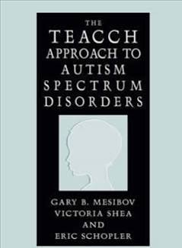
Some resources on Structured Teaching
Teacher Professional Development
Website & Articles
Go to the following link and download each of the four pdf articles on Structured Teaching
https://www.iidc.indiana.edu/pages/Structured-Teaching-Strategies-A-Series
Book by Gary Mesibov, Victoria Shea and Eric Schopler (2006), Springer.
Written by some of the co-founders of the TEACCH program and colleagues. This book describes the philosophy and practices of the TEACCH program since its inception almost 30 years ago to the current development of the internationally-renowned TEACCH centre in the United States, which offers interdisciplinary services and training.
There may be slight variations in
information but the principles are the same

Slide 16
Some resources on Structured Teaching
Teacher Professional Development
Video (4:41) – Introduction to Structured Teaching
Click on the image or go to the following link to view a video of a primary school student on the autism spectrum in her school environment. She demonstrates her school day and how Structured Teaching strategies are used to help her in the classroom. These strategies are individualised. You may choose to use more whole-of-class strategies for all students.
https://www.youtube.com/watch?v=vkymZzmg4jw
Video (20:39) – Components of Structured Teaching
Educators demonstrate how they implement Structured Teaching in action in the mainstream classroom. Practical examples of how they have adapted the curriculum and learning activities into a structured form. These examples may be adapted further to suit the age and ability of students in your classroom.
There may be slight variations in
information but the principles are the same
https://vimeo.com/15113443

Slide 17
Teacher Professional Development
A Final Note
This Teacher Professional Development on Structured Teaching: An Introduction was created and developed by Dr Satine Winter with the assistance of Stephanie Callaghan and overseen by Dr Jill Ashburner, Autism Queensland.
The information contained within is adapted from the ‘Finished! The On-Task Toolkit – A teacher’s guide to using visual schedules and work systems in the mainstream classroom’ by Elizabeth Macdonald (Autism CRC funded PhD scholar, Griffith University) and Kaaren Haas (Autism Spectrum Australia, Aspect). Animated images were created by Studio G, Autism Queensland.
Funding for this project was provided by Positive Partnerships and facilitated through project collaboration between the Autism CRC, Autism Queensland, Positive Partnerships, Autism Spectrum Australia (Aspect) and the University of Queensland.
Thank you!

Slide 18
Teacher Professional Development
References
Hume, K., Plavnick, J., & Odom, S. L. (2012). Promoting task accuracy and independence in students with autism across educational setting through the use of individual work systems. Journal of Autism and Developmental Disorders, 42, 2084-2099. doi:10.1007/s10803-012-1457-4
Hume, Kara. (2015). Structured Teaching Strategies: A Series. Resource Center for Autism. http://www.iidc.indiana.edu/?pageId=3520Indiana
Hume, K. & Odom, S. (2007). ‘Effects of an individual work system on the independent functioning of students with autism.’ Journal of Autism and Developmental Disorders, 37, 1166–80.
Knight, V., Sartini, E., & Spriggs, A. D. (2014). Evaluating visual activity schedules as evidence-based practice for individuals
with autism spectrum disorders. Journal of Autism and Developmental Disorders, 45, 157-178. doi:10.1007/s10803014-2201-z
MacDonald, E. (2017). The use of structured teaching strategies to support students on the autism spectrum to stay on task in mainstream classrooms (Unpublished doctoral dissertation). Griffith University, Brisbane.
MacDonald, L., Keen, D., Ashburner, J., Costley, D., Haas, K., & Trembath, D. (2017). Piloting autism intervention research with teachers in mainstream classrooms. International Journal of Inclusive Education, 21, 1228-1224. doi:10.1080/13603116.2017.1335355

Slide 19
Teacher Professional Development
References
Mesibov, G. B., & Shea, V. (2011). Teacch. In J. S. Kreutzer, J. DeLuca, & B. Caplan (Eds.), Encyclopedia of Clinical Neuropsychology (pp. 2472-2477). New York, NY: Springer.
Mesibov, G. B., Shea, V., & Schopler, E. (2004). The TEACCH approach to autism spectrum disorders. New York: Springer.
O'Hara, M., & Hall, L. J. (2014). Increasing engagement of students with autism at recess through structured work systems. Education and Training in Autism and Developmental Disabilities, 49, 568-575.
Schopler, E., Mesibov, G., & Hearsey, K. (1995). Structured teaching in the TEACCH system. In E. Schopler & G. Mesibov (Eds.), Learning and Cognition in Autism (pp. 243-268). New York: Plenum Press.
Schopler, E., Brehm, S., Kinsbourne, M. & Reichler, R. (1971) ‘Effect of treatment structure on development in autistic children.’ Archives of General Psychiatry, 24, 415–421.

Slide 20
Autism CRC is the world’s first national, cooperative research centre focused on autism. We are taking a whole-of-life approach to autism focusing on early years, schools years and adulthood.

